Slide 1




Braille keyboard for smartphones & personal computers for the blind
NIDHI-PRAYAS| Month 1 (Jan 2023)
Hathi Labs Pvt. Ltd
Vijay Raghav Varada

Slide 2
Q1 Workplan
Sub-Task | Month 1 | Month 2 | Month 3
R&D/Design Engg/Consultancy/testing/Expert | Design Documentation, Feature requirements, Technical Evaluation | PCB Design, CAD Design Rev 1 | PCB Design, CAD Design Rev 1 (Cont.)
Budget |  | 35000 | 35000
Procuring Raw materials and consumables (example given to show the mapping) | Component Finalisation, Final Vendor Quotes | Mechanical Component Procurement : | Electronic Component Procurement :
Budget |  | 90000 | 30000

Slide 3
Month 1 Task Progress
Task | Progress | Status | Budget | Utilized
Feature requirements | Created Github Repository with feature requirements | Done | None | None
Design Documentation | Added High level system architecture and functionality, added to Github | Done | None | None
Technical Evaluation | Evaluated of various BOM components for electronics | Done | None | None
Component Finalisation |  | Ongoing | None | None
Final Vendor Quotes |  | Not Started | None | None

Slide 4
Month 1 Tasks Progress
Task | Progress | Status | Budget | Utilized
Feature requirements | Created Github Repository with feature requirements | Done | None | None
Design Documentation | Added High level system architecture and functionality, added to Github | Done | None | None
Technical Evaluation | Evaluated of various BOM components for electronics | Ongoing | None | None
Component Finalisation | Finalised a few electronic components for PCB | Ongoing | None | None
Final Vendor Quotes |  | Not Started | None | None

Slide 5
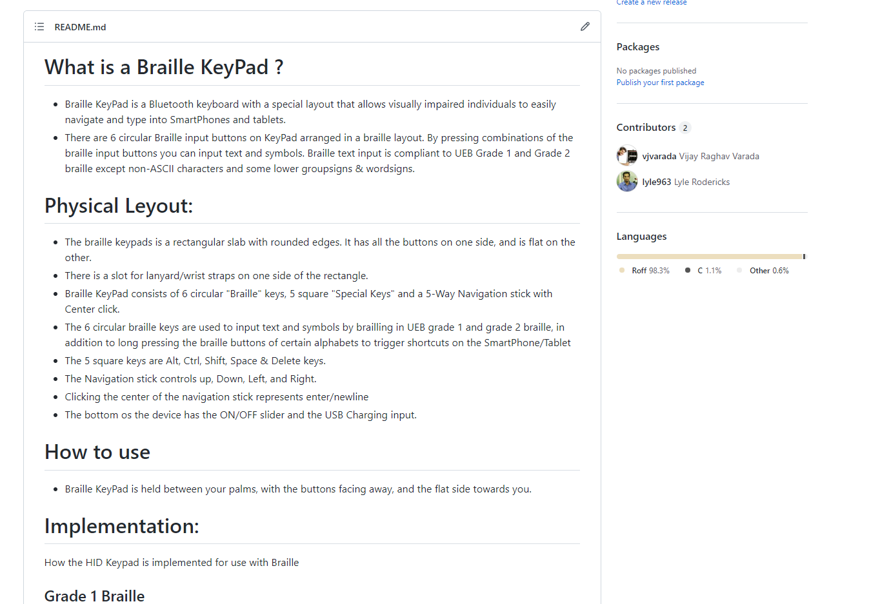
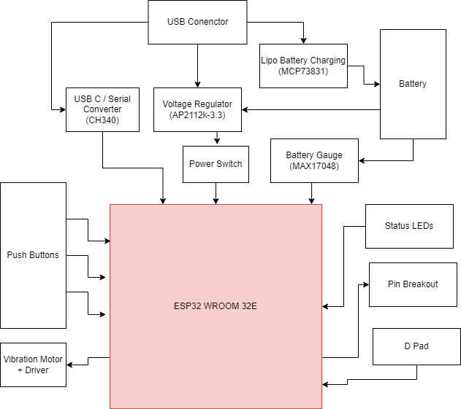
Hardware Documentation
Full documentation available at https://github.com/vjvarada/Tipo-Braille-Keyboard

Slide 6
References
Braille Code Referance: https://www.pharmabraille.com/braille-codes/unified-english-braille-ueb-code/
Test and understand using online braille translator: https://www.branah.com/braille-translator
Wikipedia entry https://en.wikipedia.org/wiki/English_Braille
http://www.dotlessbraille.org/brailleindicators.htm#markup
Android & TalkBack Mobile Accessibility Cheat Sheet https://pauljadam.com/demos/talkbackcheatsheet.html
Keyboard Shortcuts https://www.cnet.com/culture/keyboard-shortcuts-for-android-phones/
Talkback Shortcuts https://dequeuniversity.com/screenreaders/talkback-shortcuts
Braille to Binary encoder https://www.dcode.fr/braille-alphabet

